Slide 1
Eagle CAD Workshop (6)
How to Read: PMIC

Slide 2
PMIC
Power Management IC
Miniaturized version of voltage regulator
Ideal for small electronics; your microcontroller board
Not so ideal when it comes to high-power requirements.

Slide 3
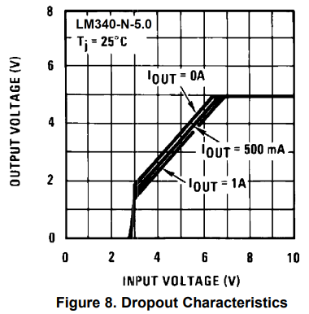
What Types?
Two Major Types
Linear
Input vs. Output graph has linear characteristic
Non-Linear
Boost Topology
Buck Topology

Slide 4
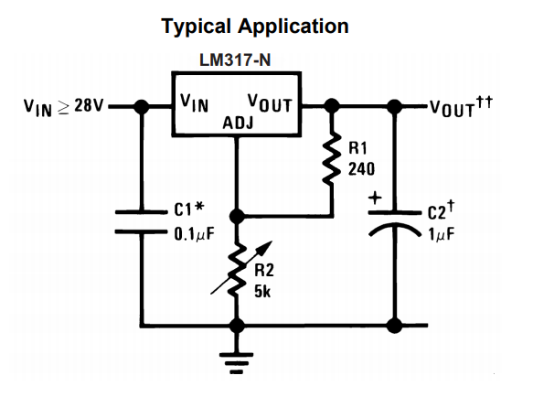
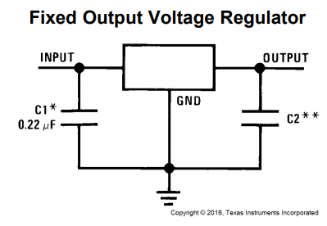
Then It Splits Into…
Output Characteristic!
Fixed Output
Outputs fixed voltage as long as input voltage sustains.
Variable Output
Can adjust output by sending ‘feedback’ voltage back to adjustment pin

Slide 5
Ready To Get One?
LM2940CT-5.0/NOPB
Things to look for
Output Configuration
Output Type
No. of Regulators
Max. Input Voltage
Output Voltage (Fixed)
Max. Dropout Voltage
Output Current

Slide 6
Things To Look For
Output Configuration
Positive or Negative Output?
Output Type
Fixed? Adjustable?
No. of Regulators?
Means number of outputs
Max. Input Voltage
How high can you input voltage?
Output Voltage
What is the output voltage?

Slide 7
Things To Look For (Cont.)
Max. Dropout Voltage
What is the MINIMUM voltage we must supply?
1V @ 1A
Means we need at least (Output)+1V @ 1A to successfully supply 5V, 1A of power.
Output Current
Max. output current.

Slide 8
Watch Out For Temperature!
Some PMICs output less power when it gets hot/cold.
Generally, higher the temperature, higher the internal resistance they get.

